Slide 1
CSE 405
I/O Interfacing
Osama Hosameldeen
Spring 2021
Lecture 8: Software Interrupts

Slide 2
contents
© 2015 ELSIVER, All rights reserved. compiled by Dr. Osama Hosameldeen

Slide 3
Revisiting hardware interrupts
© 2015 ELSIVER, All rights reserved. compiled by Dr. Osama Hosameldeen

Slide 4
Consider the ‘yes’ case
Fetch next instruction
Advance instruction-pointer
Decode fetched instruction
Execute decoded instruction
INTR
?
Interrupt
Service
Routine
no
yes
The Interrupt Service Routine may do some arithmetical or logical operations that
cause FLAGS to be modified – and so invalidate the program’s conditional-jump!

Slide 5
The CPU solves this problem
When an interrupt-request is recognized by the CPU, it automatically ‘saves’ the crucial elements of its program-context
Thereby it can ‘resume’ its main program (after it services the interrupt) with these crucial register-values restored:
  The address of the next instruction (CS:IP)
  The previous settings of the FLAGS bits

Slide 6
The ‘interruption’ senario
Programmable
Interrupt
Controller
(PIC)
Central
Processing
Unit
(CPU)
Dynamic
Random
Assess
Memory
(DRAM)
INTR
SS
SP
INTA
interrupt
handler
FLAGS
CS
IP
stack-area
main program
peripheral device
(keyboard, mouse, timer, etc)
Interrupt
Vector
Table

Slide 7
The sequence of actions
Some device issues an interrupt-request
Interrupt Controller forwards it to CPU
CPU saves FLAGS, CS, and IP on stack
CPU issues acknowledgement to PIC
PIC sends Interrupt ID-number to CPU
CPU uses ID-number as index into IVT and loads CS and IP with vector-values

Slide 8
What the ISR works with
The Interrupt Service Routine begins with the its stack setup like this:
+4
Saved FLAGS value
+2
Saved CS-value
+0
Saved IP-value
SS:SP (“top” of the stack)
room here for the stack
to grow downward
as needed
If the ISR needs to use any of the
other CPU registers, it should push
their values onto the stack before
it modifies them, then pop those
saved values back before returning

Slide 9
What does ‘iret’ do?
An Interrupt Service Routine concludes by executing an ‘iret’ instruction -- to resume whatever program had gotten interrupted, and with its FLAGS restored as they were
So what ‘iret’ does is to ‘pop’ the top three word-values off the stack and into the IP, CS, and FLAGS registers, respectively

Slide 10
Software Interrupts
© 2015 ELSIVER, All rights reserved. compiled by Dr. Osama Hosameldeen

Slide 11
Software interrupts and processor exceptions
Software interrupts happens within the processor itself.
They are a result of the processor executing a specific instruction or sequence of instructions.
They are generally used to provide a means of communicating with other software processes such as DOS or the PC’s BIOS
Processor exceptions, arise due to error such as an attempt to divide by zero.
© 2015 ELSIVER, All rights reserved. compiled by Dr. Osama Hosameldeen

Slide 12
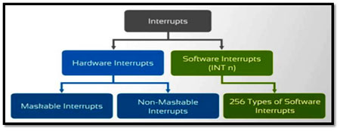
Software interrupts
Software interrupts are used on the PC as a way of implementing address-independent interprocess software calls.
Many PC programs use the software interrupt mechanism for accessing the BIOS and operating-system services.
© 2015 ELSIVER, All rights reserved. compiled by Dr. Osama Hosameldeen

Slide 13
The interrupt sequence
Software interrupts are managed by the processor. So, the problem of shared resource access is not encountered here.
However, the operation of the two types of interrupts (HW, SW interrupts) are very similar.
The sequence is as follow
the processor pushes the Flags register, clears the Interrupt Flag (IF) and the Trap Flag (TF) and then pushes the CS and IP registers onto the stack.
© 2015 ELSIVER, All rights reserved. compiled by Dr. Osama Hosameldeen

Slide 14
The interrupt sequence
The processor pushes the Flags register, clears the Interrupt Flag (IF) and the Trap Flag (TF) and then pushes the CS and IP registers onto the stack.
During this process the processor also retrieves the address (CS:IP) of the interrupt handler from the IVT and then transfers control to the handler.
The interrupt handler return control to the calling process by issuing an IRET instruction, no need to issue PIC’s EOI signal
© 2015 ELSIVER, All rights reserved. compiled by Dr. Osama Hosameldeen
Notes:
IVT, interrupt vector table.

Slide 15
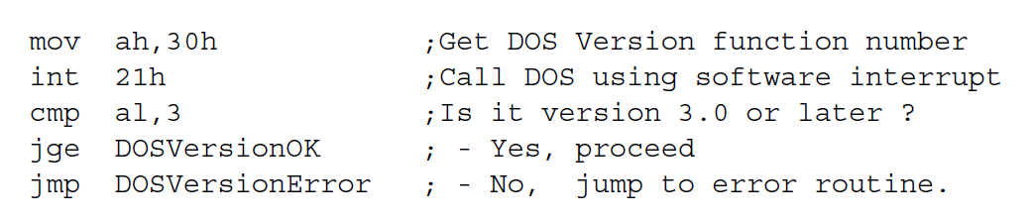
Issuing a software interrupt in assembly language
Done by means of the 2-byte INT instruction. First byte is CDh opcode and the second byte may be any number from 0 to 255.
example calls the Get DOS Version function, as denoted by the value of 30h placed into the AH register, and then checks to see whether it is version 3.0 or later.
© 2015 ELSIVER, All rights reserved. compiled by Dr. Osama Hosameldeen

Slide 16
Software interrupt priority
The index into the IVT is usually obtained from the interrupt (INT) instruction itself.
When a software interrupt occurs, the processor clears the Interrupt Flag
This means that all maskable (i.e. external hardware) interrupts will be disabled until the interrupt handler either issues an STI instruction or returns with an IRET
Software interrupts have a higher priority than either of the hardware (INTR or NMI) interrupts
© 2015 ELSIVER, All rights reserved. compiled by Dr. Osama Hosameldeen

Slide 17
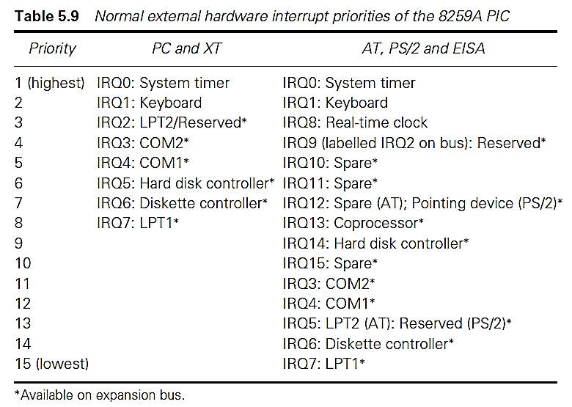
Updating priorities.
It is possible for software to modify the effective priorities of the interrupts by reprogramming the PIC(s)
© 2015 ELSIVER, All rights reserved. compiled by Dr. Osama Hosameldeen

Slide 18
Updating priorities.
The processor itself should prioritize all interrupts:
  Hardware interrupts on INTR line,
  NMI
  Processor exception.
  Traps and software interrupts.
In general, processor faults (divide by zero) and traps (e.g. debug trap) have the highest priority. External hardware interrupts has lowest priority.
© 2015 ELSIVER, All rights reserved. compiled by Dr. Osama Hosameldeen

Slide 19
Interrupt Handlers
Interrupt handlers are important for DA&C.
Interrupt modules are programmed to read from terminal or serial port whenever data becomes available.
Also used for pacing and time keeping. Periodic interrupts from the system timer or from an external device allow the software to perform actions at regular intervals.
It is possible to use interrupt to detect or filter out specific key combinations (such as Ctrl-Alt-Del) by intercepting the keyboard interrupt.
© 2015 ELSIVER, All rights reserved. compiled by Dr. Osama Hosameldeen

Slide 20
Interrupt Handlers
Finally, and perhaps most importantly, the interrupt system allows the programmer to trap specific error conditions (e.g. a divide by zero) and events such as a Ctrl-C or Ctrl-Break interrupt.
This consideration is generally of most importance to assembly language programmers since most high level languages (HLLs) incorporate mechanisms for automatically trapping these interrupts.
Nevertheless, all users of HLLs should be familiar with the error trapping facilities of their compiler
© 2015 ELSIVER, All rights reserved. compiled by Dr. Osama Hosameldeen

Slide 21
Installing interrupt handler
In order to install an interrupt handler, the corresponding interrupt vector must be modified so that it points to the new routine.
IV entry is either added in the “reserved for future use section” or the already existing IV is updated and points to the new handler.
Two ways to modify interrupt vector:
  Via operating system functions or
  By directly accessing IVT in low memory
C language provides two functions to access interrupt vector, getvect() and setvect()
© 2015 ELSIVER, All rights reserved. compiled by Dr. Osama Hosameldeen

Slide 22
Installing interrupt handler
The direct modify of IVT might be needed in real time data acquisition applications.
The only condition is that there is no possibility of an interrupt occurring while IVT is being accessed.
It is usually safe to disable all hardware interrupts during IVT access.
We know that IVT is 1KB long located at address 0. each vector holds 4 bytes. The vector of type n is located at location 4n.
© 2015 ELSIVER, All rights reserved. compiled by Dr. Osama Hosameldeen

Slide 23
Exceptions
Interrupts caused by interrupt-requests sent by I/O devices.
Interrupts could be used in many other situations where the execution of one program needs to be suspended and execution of another program needs to be started.
In general, the term exception is used to refer to any event that causes an interruption.
  Interrupt-requests from I/O devices is one type of an exception.
Other types of exceptions are:
  Recovery from errors
  Debugging
  Privilege exception

Slide 24
Exceptions (contd..)
Many sources of errors in a processor. For example:
  Error in the data stored.
  Error during the execution of an instruction.
When such errors are detected, exception processing is initiated.
  Processor takes the same steps as in the case of I/O interrupt-request.
  It suspends the execution of the current program, and starts executing an exception-service routine.
Difference between handling I/O interrupt-request and handling exceptions due to errors:
  In case of I/O interrupt-request, the processor usually completes the execution of an instruction in progress before branching to the interrupt-service routine.
  In case of exception processing however, the execution of an instruction in progress usually cannot be completed.
Notes:
Exceptions occur when a processor is trying to recover from errors. Exceptions occur when the processing of one program needs to be suspended and the other one needs to be resumed. When an error occurs while executing a program, the execution of that program needs to be suspended and appropriate error handling needs to be initiated. There are various sources of error in a processor. For example, an error could be present in the data or instruction that is stored. The machine language code of the instruction may be wrong. Also, errors could occur during the execution of an instruction, for example dividing a number by zero causes an exception. When such errors are detected, exception processing is initiated by the processor. In order to initiate exception processing, same steps are taken as in the case of I/O interrupt request. The execution of the present program is suspended, and we start execution an exception service routine.
Although exception processing and interrupt request processing is similar, there are subtle differences between handling I/O requests and handling exceptions due to errors. When a processor receives I/O interrupt requests, the processor usually completes the execution of an instruction in progress before branching to the interrupt service routine. In case of exception processing however, an error occurs during the execution of the instruction in progress, and hence the execution of the instruction that caused an exception cannot be completed.

Slide 25
Exceptions (contd..)
Debugger uses exceptions to provide important features:
  Trace,
  Breakpoints.
Trace mode:
  Exception occurs after the execution of every instruction.
  Debugging program is used as the exception-service routine.
Breakpoints:
  Exception occurs only at specific points selected by the user.
  Debugging program is used as the exception-service routine.
Notes:
The other scenario where exceptions are used is in the case of debuggers. Debuggers use exceptions to provide important features such as tracing and breakpoints. When the debugger is used in the trace mode, the execution of the program needs to be stopped after every instruction so that the contents of the variables can be examined. The way the trace mode is implemented is that exception occurs after the execution of every instruction, and the debugging program is used as the exception service routine. The debugging program enables you to examine the contents of the variables that you like.
In case of breakpoints program execution is halted only at specific points selected by the user. Once again, the debugging program is used as the exception service routine.

Slide 26
Exceptions (contd..)
Certain instructions can be executed only when the processor is in the supervisor mode. These are called privileged instructions.
If an attempt is made to execute a privileged instruction in the user mode, a privilege exception occurs.
Privilege exception causes:
  Processor to switch to the supervisor mode,
  Execution of an appropriate exception-servicing routine.
Notes:
Recall privilege mode and supervisor mode. Certain instructions can only be executed in the supervisor mode. If an attempt is made to execute the instruction in the user mode, then an privilege exception occurs. Privilege exception causes the processor to switch to the supervisor mode, and execution of an appropriate service routine.

Slide 27
contents
© 2015 ELSIVER, All rights reserved. compiled by Dr. Osama Hosameldeen

